Slide 1

S.M.A.R.T
https://www.youtube.com/watch?v=FFT6uP1fIFI

Slide 2
Example of a Goal
I will increase the amount of vegetables I eat daily.

Slide 3

S=Specific – A precise detail that should be included in your goal like an amount, quantity, length, weight, etc.
Have 1.5 cups of vegetables for lunch and
1.5 cups at dinner time.

Slide 4
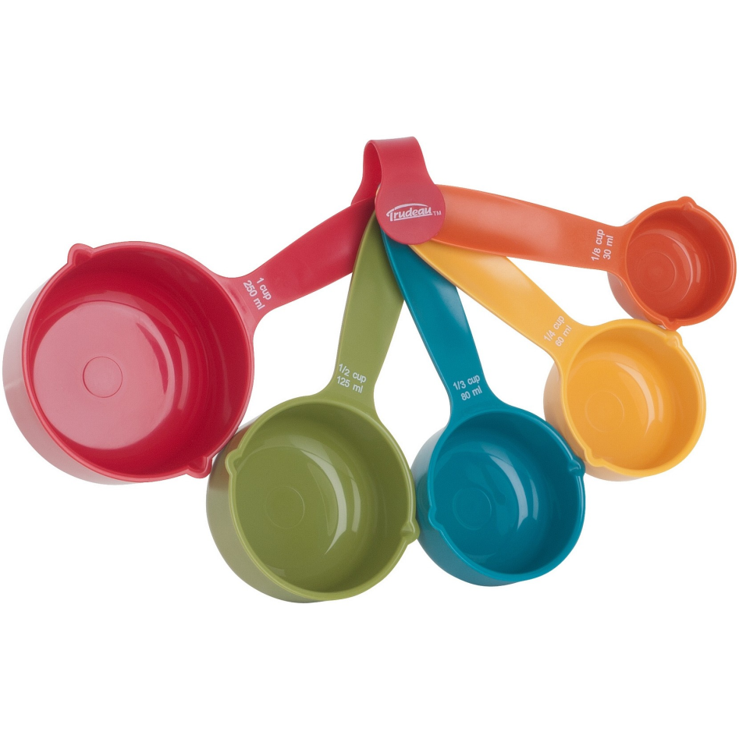
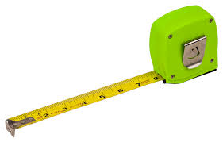
M=Measurable -How will you keep track of your goal)
Measure with measuring cup to ensure I eat 1 cup and use My Fitness Pal to track my diet daily so I can keep track of my vegetable intake.

Slide 5


A=Attainable- how will you be able to make your goal achievable/feasible. (baby steps)
I am going to start the first week by only having 1 serving of vegetables a day, then add 1 more serving thereafter.

Slide 6


R=Realistic-making sure that your goal is within reach, not too difficult.
Ensure that I buy vegetables that I really like the taste of.
Only adding 3 more servings since anything over 3 would be too difficult.

Slide 7
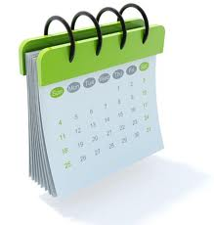
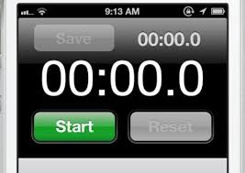
T=Timely~ What date will you reach this goal by?
I am going to work on this goal until January 1st of this year.

Slide 8


